Slide 1
COMP 3617
Week 3

Slide 2
Agenda
Android Resources
User Interface Elements
Layouts
Linear Layout
Relative Layout
Frame Layout
Input Controls
Text Fields
Buttons
Checkboxes
Radio Buttons
Toggle Buttons

Slide 3
Recap

Slide 4
Resources
Resources are used to define strings, colors, images, layouts and menus
Define resource files and reference them in code
Android externalizes resources from application code so both can be maintained independently
Allows for providing alternative resources for specific device configurations like languages and screen sizes
Resources are defined under res/ folder of the Android project

Slide 5
Android Resource folders
Last week we briefly saw activities user interface was defined by an xml file under a folder called layout (/res/layout)
Common resource folders under res/ are
Folder Name | Description
drawable/ | Bitmap files (.png, .jpg, .gif)
menu/ | Define application menus
raw/ | Any file in raw form
values/ | XML files that contain simple values – strings, integers, colors. Values files define multiple resources.
layout/ | XML files that define a user interface layout
xml/ | Arbitrary XML files

Slide 6
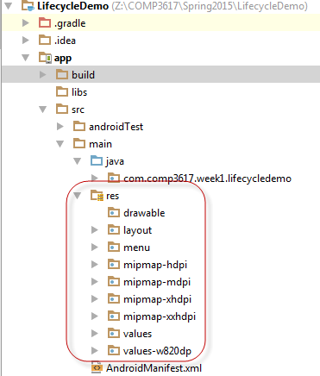
Android Resource folders
A Sample Android Studio project showing the resource folders
Caveat: Do not place resource files directly inside the /res folder – generates a compilation error

Slide 7
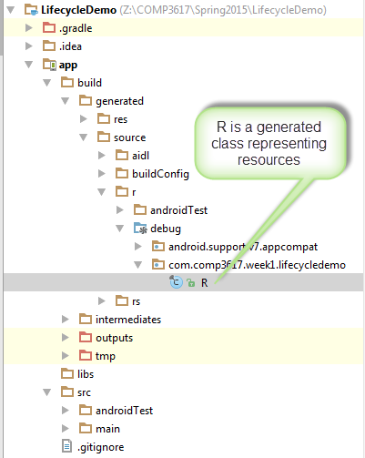
Android Resource Folders
/res folders contents can be accessed in code via the generated R.java file
Do not modify the R.java file manually

Slide 8
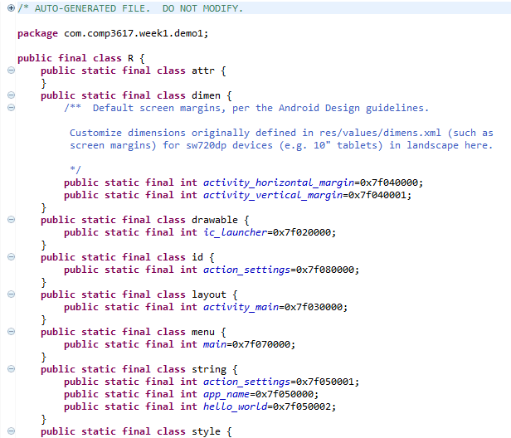
Sample R.java generated file

Slide 9
R.java
During compilation Android tools inspect the folders under res directory and create a corresponding ID in the R.java file
R.java is created and placed separately from application source code
Never change the R.java file as it will be overwritten by the Android tools

Slide 10
R.java
The IDs in R.java are used extensively in Android APIs
Android compiles the XML files into a packaged binary format for better performance

Slide 11
Accessing Resources
Resources are referenced in code via the Resource ID from R.java class
Each resource has an inner static class inside the R class – like string, layout etc
Resource ID is always composed of resource type (string, layout, etc) and resource name
Referring to the app resources in XML employ the following syntax : @resource_type/resource_name
Eg: @string/next, @drawable/stanley_park_img

Slide 12
View Identifier
A View can have an id associated with it that uniquely identifies the view for later access
ID is typically assigned in the XML layout like so <TextView android:id=“@+id/tvMsg”/>
The View associated with the ID can be accessed in the Activity like so
TextView tv = (TextView) findViewById(R.id.tvMsg)
Views are referenced with their IDs typically in the onCreate() method of the activity

Slide 13
Accessing Resources in Code
Any resource can be used in code by passing in the resource ID as a method parameter
Here is an example of setting an image resource

Slide 14
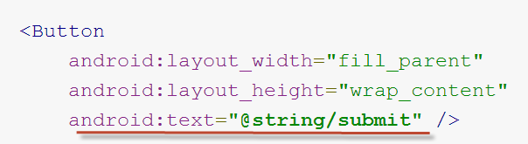
Accessing Resources from XML
Common convention is that values for some XML attributes are defined using a reference to an existing resource
For example if you define a button, the text for the button should be specified using a string resource
submit is defined in the strings.xml file
Notes:
If you referring to resource defined in the Android SDK then you use android: prefix in the value. For example to set the text color android:textColor=@android:color/white

Slide 15
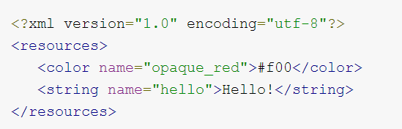
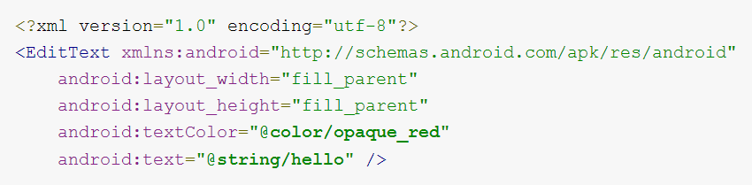

Accessing Resources from XML

Slide 16
Drawable Folders
Drawable in Android is something that can be drawn on the screen
Abstraction for colors, shapes and images
Drawable is a superclass to deal with these types
Two main types of drawable objects
Image resources
XML files that describe the drawing or pieces of it (eg: color, gradient, shapes)
Multiple drawable folders to support different screen densities/resolutions

Slide 17
Values Folder
Define constants specific to user interface (eg: strings, colors, int arrays, string arrays)
Values folder typically contains
Strings – strings.xml file contains the string literals used in the UI
Colors – colors.xml – color constants for backgrounds and text colors
Styles – styles.xml – defines styles that can be applied to various widgets
Dimensions – dimens.xml – defines size values that can be used in the layouts

Slide 18
Default Resources vs Alternative Resources
Default resources define the default design and content for the app
Default resources live inside the standard folders (folders without a hyphen and qualifier ) under res/
Alternative resources support specific device configurations Eg: mipmap-hdpi, values-es
Configuration qualifiers are added to the default resource folders with a hyphen

Slide 19
Declaring UI in XML
Building UI – Android supports both Declaratively (XML) or Imperatively (Java)
Most moderns frameworks define UI (Presentation) in XML and Business Logic (Behavior) in Java
Android allows for both mechanisms but favors defining the UI declaratively
Allows for easy modifications to the UI
Tooling support is easier with Declaratively based UI
Allows for easy visualization of the structure

Slide 20
Layout
Layout specifies what the user interface looks like for an activity
Layout is an XML file that comprises of Views and ViewGroups
Activity uses the layout to render the user interface associated with the activity
Activity is written in Java and describes the behavior of an activity

Slide 21
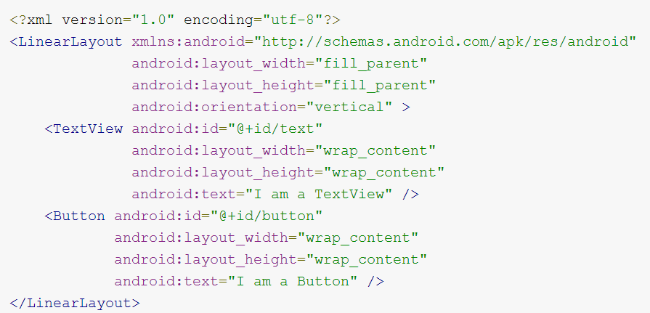
Layout Sample

Slide 22
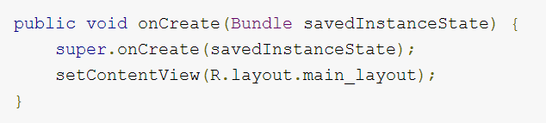
Activity Layout relationship
A layout defines how the visual elements are arranged on the screen
An activity loads the layout resource in the onCreate callback, called by the Android platform when the Activity is launched
Activity then sets the loaded layout as the view for itself

Slide 23
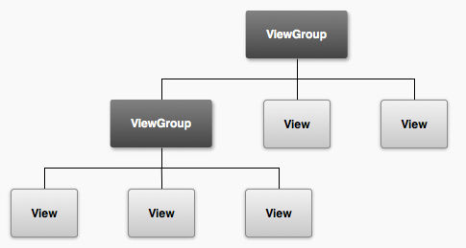
Views and ViewGroups
User interface layout is defined using Views and ViewGroups organized in an XML file
Each layout is a tree made up of Views and ViewGroups
A layout defines the visual structure of an user interface for an activity

Slide 24
Views and ViewGroups
A View is an object that draws something on the screen the user can interact with Eg: Button, Label, TextView etc
ViewGroup is a container object that holds other views and view groups
ViewGroup defines the layout of the interface

Slide 25
Views/ViewGroups Attributes
Every View and ViewGroup supports a number of XML attributes
Some of the attributes are common (eg:id) as each type of view and view group inherits from the common base class – android.view.View
A View object may have an integer ID associated with it to uniquely identify the View in the tree and can be used to programmatically reference it in code

Slide 26


Views/ViewGroups Attributes
Syntax for the ID attribute is
@ symbol indicates to the XML parser that it is an ID resource
+ sign means that this is a new resource that must be added to the resource (in R.java)
When referencing an Android resource ID, it does not use + sign, but should be qualified by android package namespace

Slide 27
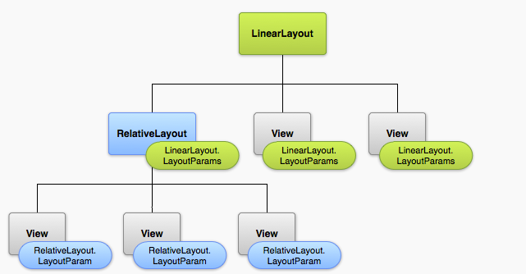
Layout Parameters
Attributes name layout_xxx define layout parameter for the view in relation to the ViewGroup it resides in
layout_width, layout_height, layout_weight

Slide 28
Layout Parameters
Every view must define Layout attributes that are appropriate for its parent
All views include a width and height, and each view is required to define them
Most often the height and width are specified to be symbolic constants
wrap_content – Dimensions are specified by the content the view holds
match_parent – Dimensions of the view are as big as its parent view group will allow

Slide 29
Common Layouts
Different subclasses of ViewGroup allow for different placement options for the view in it
Layouts can be nested but nesting too deep causes performance issues
Common layouts are
Linear Layout
Relative Layout
Frame Layout
TableLayout (Not covered in the course)
GridLayout (Not covered in the course)

Slide 30

Linear Layout
Horizontal Orientation
Vertical Orientation

Slide 31
Linear Layout
Aligns all child views in a single direction – horizontally or vertically
Child views are stacked one after the other
Gravity property determines the left/right/center alignment of the child view
Linear layout can assign weights to individual child views – a larger weight allows it to expand to fill any remaining space

Slide 32
Linear Layouts Characteristics
Orientation – determines if the child views are placed horizontally or vertically
Weight – determines how to allocate size for the view remaining after all other view sizes have been allocated
Gravity – specifies where to draw the contents of a view

Slide 33
Special Dimensions
All Views require layout height and width to be specified
You can specify absolute values or predefined constants
Predefined constants are
wrap_content – Make the view big enough to match its contents
match_parent – Match the dimensions of this view to match the dimensions of the parent view
fill_parent – Same as “match_parent”. Deprecated

Slide 34
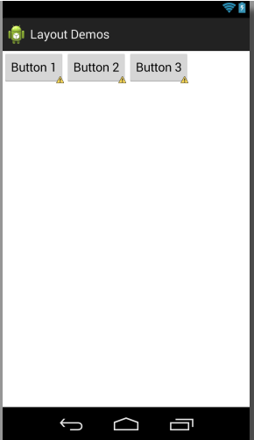
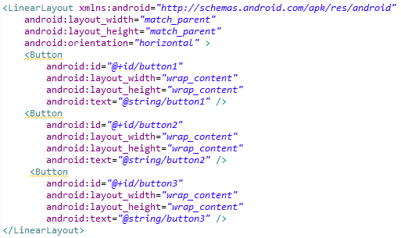
Linear Layout (Horizontal Orientation)

Slide 35
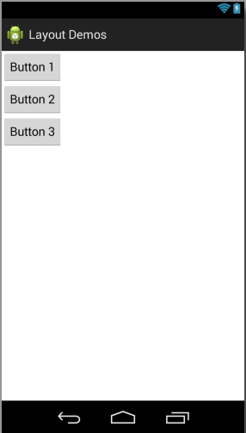
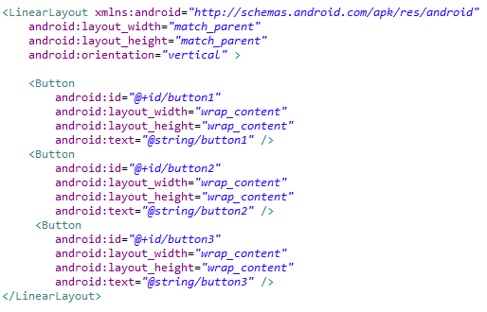
Linear Layout (Vertical Orientation)

Slide 36
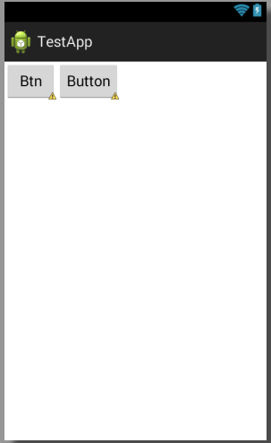
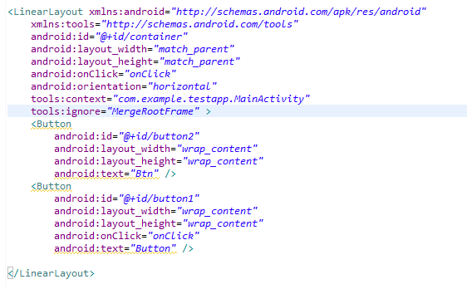
Layout Weight
Default layout weight is 0

Slide 37
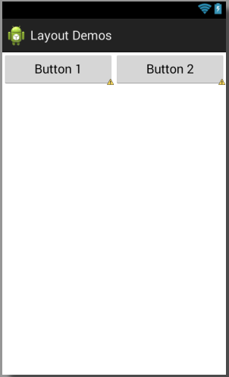
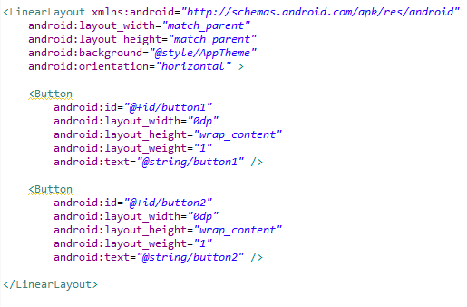
Layout Weight
Notice width is set to 0
Weight of both the buttons are 1, so evenly distributed

Slide 38
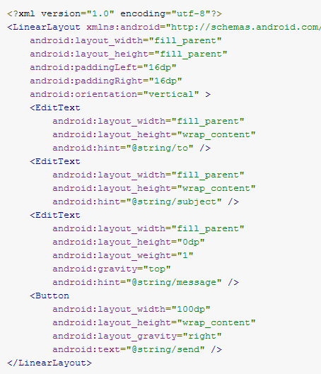
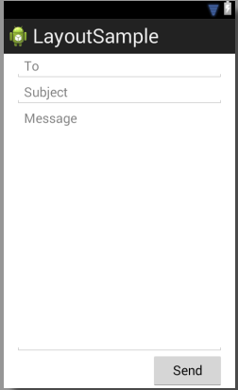
Linear Layout
Remaining space is filled by edit text for message

Slide 39
Layout Gravity
Tells the parent Layout container how to align the children
For horizontal Linear Layout you can use – top, center, bottom
For vertical Linear Layout you can use – left, center, right

Slide 40
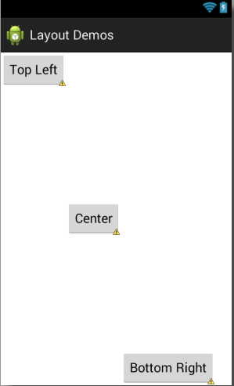
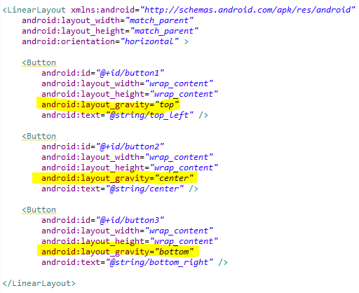
Layout Gravity (Horizontal Orientation)

Slide 41
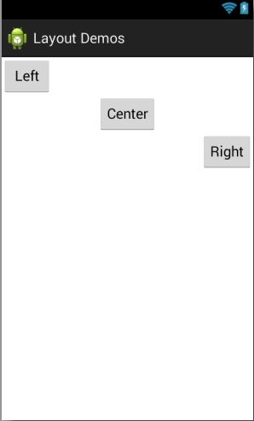
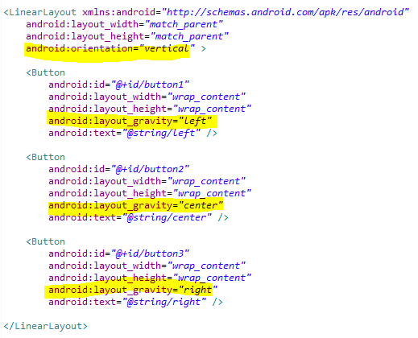
Layout Gravity (Vertical Orientation)

Slide 42

Relative Layout
Each view’s position can be specified as a relative to another sibling view or relative to the parent Relative Layout

Slide 43
Relative Layout
Some of the relative layout properties are
Attribute | Description
layout_alignParentTop, layout_alignParentBottom, layout_alignParentRight, layout_alignParentLeft | Makes the child view align with the parent
layout_centerHorizontal, layout_centerVertical, | Center a child view horizontally or vertically within a parent
layout_above, layout_below, layout_leftOf, layout_rightOf | Positioning a sibling view relative to another sibling
layout_alignTop, layout_alignBottom, layout_alignLeft, layout_alignRight, layout_alignBaseline | Alignment based on the siblings

Slide 44
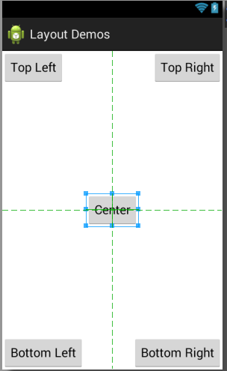
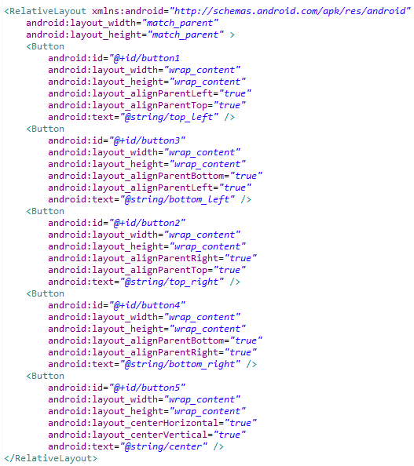
Relative Layout

Slide 45
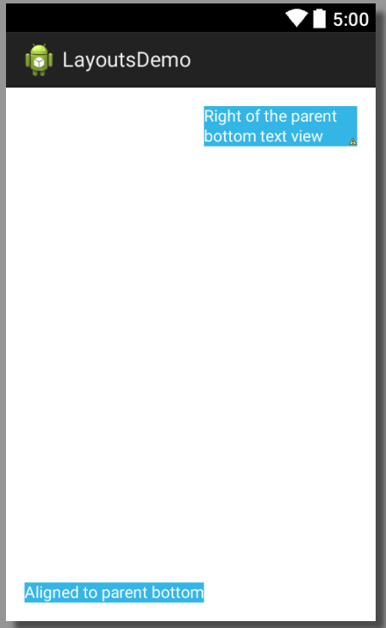
Relative Layout

Slide 46
Relative Layout
Top Right button is relative to the parent container
Second button is placed below first button – relative to first button
Top Right
Ok
Relative Layout

Slide 47
Frame Layout
Positions its children on top of each other
Should be generally used to hold a single child view
When using multiple children, layout_gravity can be used to control their position
Child views are drawn in a stack with the most recent views added child on top

Slide 48
Specifying Size : Pixels vs DPs
Android supports different screen sizes and densities
Specifying size in pixels is a bad practice in Android as it does not scale well across the different device configurations
Density-independent pixels (dps) is a virtual pixel and it should be used when specifying size
Specifying size in dps allows Android to scale the size appropriately on different device configurations

Slide 49
Common Controls/Views/Widgets
Control (Class Names) | Description
Button (Button) | Push button
Label (TextView) | Displays text that the user cannot change
Text Field (EditText) | Editable text field for user input
Checkbox (CheckBox) | An on/off switch to be toggled by the user
Radio button (RadioGroup and RadioButton) | Similar to checkboxes except only one option can be selected in the group
Toggle Button (ToggleButton) | On/off button with a light indicator

Slide 50
Button
Button invokes an event handler
Event handlers can be defined in multiple ways
To respond to button clicks, define a method in the host activity and set the onClick property of the button to refer to the method
Alternatively an onClickListener can be defined on the button as well
Image Button - a variant of a button that displays an image

Slide 51
TextView
Displays text
Common Properties are
TextStyle – normal, bold, italic
TextColor – specified as #RGB with an optional apha channel
TextSize – specified in sps (Scale Independent pixels). 15sp - normal
Typeface – sans, monospace, serif, normal

Slide 52
EditText
EditText allows for input to be captured
Text fields can have different input types – numbers, date, etc. Adding inputType attribute constrains what can be input
Common inputType attribute values are
text – normal text
textEmailAddress – normal text keyboard with @ character
number – basic number keypad
textUri – Text keyboard with / character
phone – Phone style keypad

Slide 53
EditText
Interesting Properties
Hint – Provides a prompt for the user
singleLine & lines – allows one line of text
capitalize – automatically capitalize each sentence, word or character
digits – used in conjunction with inputType=“number” to restrict the digits (say 01)
maxLength – Limit total number of characters

Slide 54
Checkbox
Allow the user to check or uncheck an option
Checked property on the checkbox determines the state of the checkbox
Event handler can be defined similar to the button
The two common methods of checkbox are
setChecked(boolean)
isChecked()

Slide 55
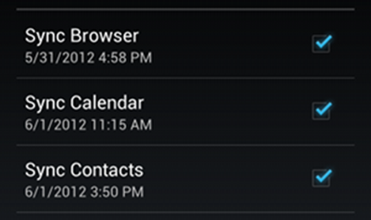
Checkbox
To respond to click events, it is similar to setting onClick event handler for a button and casting the view to CheckBox to detect whether it is checked or not

Slide 56

Radio Buttons
Allow for selection of mutually-exclusive options
RadioButton have to be grouped inside a RadioGroup container
RadioGroup is a subclass of LinearLayout
Has horizontal or vertical orientation
Has similar methods as a check box for setting and checking the status of the radio button

Slide 57

Toggle Button
Allows the user to change a setting between two states
Text for the two states are specified by textOn and textOff attributes
Newer to Android 4.0 is the switch control that provides a slider
Event handler is defined similar to the button
Alternatively OnCheckedChangeListener can be programmatically defined

Slide 58

Switch
Slider control very similar to toggle
Introduced in API 14 and above
Similar to Toggle button, it has textOn and textOff attributes
Event handler is defined similar to a button
State can be checked using isChecked() method

